Slide 1
DIGITAL Portfolio
Student name :yuvasree V
Register no and nmid :B2DDDAE7A06C998A9264621BB85CF209
Department: 2nd Bsc.information technology
College : government arts and science college Gudalur
bharadhiyar university

Slide 2
Project title
YUVASREE ‘ S PORTFOLIO

Slide 3
Agenda
* Problem Statement
* Project overview
* End user’s
* Tools and technologies
* Portfolio design and layout
* Features and functionality
* Result and screenshots
* Conclusion
* GitHub link

Slide 4
Problem statement
Problem Statement: In today’s world, individuals need an easy and professional way to showcase their skills, projects, and experiences. Many struggle to create an organized and attractive portfolio due to lack of technical or design expertise. This project aims to develop a simple, responsive, and customizable digital portfolio that helps users present themselves effectively to employers or clients.

Slide 5
Project overview
* The Digital Portfolio project focuses on creating a responsive and user-friendly website where individuals can display their skills, work samples, and achievements. It provides an accessible platform to enhance professional visibility and support career growth by offering a clean design and easy navigation.

Slide 6
Who are the end user ‘ s ?
* Students – to showcase their skills, projects, and achievements. * Job Seekers – to present their experience, work samples, and qualifications. * Employers & Recruiters – to evaluate candidates’ abilities and suitability. * Freelancers & Creators – to display their work to potential clients. * Educators & Mentors – to assess and guide learners’ progress. These users benefit by accessing, reviewing, and sharing information easily in a professional format

Slide 7
Tools and techniques of html
Tools: 1. HTML – Structure of the portfolio. 2. CSS – Styling and layout design. Techniques: 1. Responsive Design – Use media queries to make it mobile-friendly. 2. Navigation Bar – Easy access to sections like About, Projects, and Contact.

Slide 8
Portfolio design and layout
Design: Consistent Style – Use uniform colors, fonts, and spacing. User-Friendly Interface – Intuitive buttons and menus. Professional Appearance – Reflects skills and personality Layout: 1. Header – Contains name, logo, and navigation links. 2. About Section – Brief introduction and skills. 3. Projects Section – Showcase work with images, descriptions, and link

Slide 9
Feature and functionality
Features: Home Page – Overview with personal branding. About Me – Information about skills, experience, and goals. Functionality: SEO Optimization – Helps the portfolio appear in search engines. Fast Loading – Efficient code and optimized images for better performance.

Slide 10
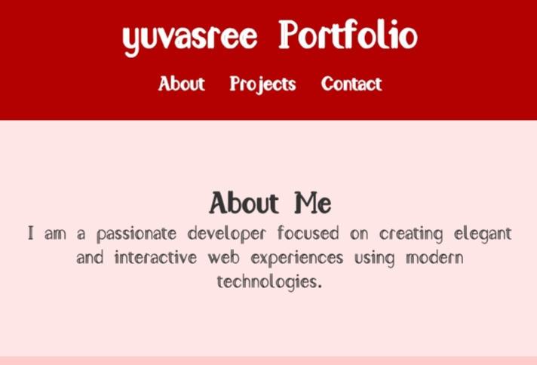
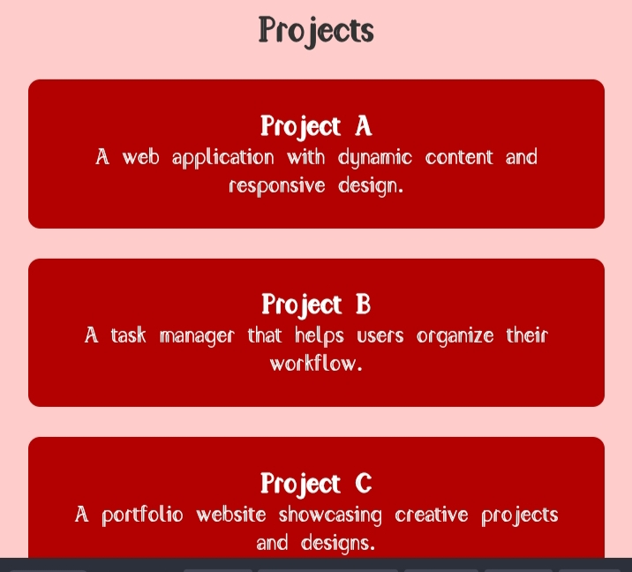
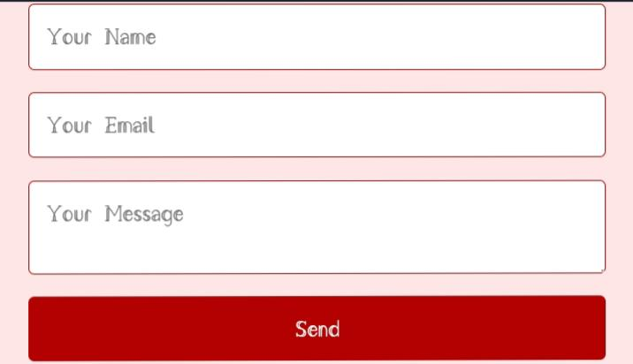
Result and screenshots

Slide 11
Conclusion
A digital portfolio is a powerful tool to showcase your skills, projects, and experience in a professional and accessible way. With a clean design, interactive features, and responsive layout, it helps create a strong online presence. It improves visibility, builds credibility, and makes it easier for employers or clients to connect with you. A well-crafted portfolio reflects your expertise and helps you stand out in today’s digital world.

